Slide 1
DEEP LEARNING
Assignment
By: Aishwarya Chaluvadi
SBMBAL21001

Slide 2
Introduction
Machine learning and Deep learning have become new and effective strategies commonly used by financial managers to maximize their profits.
Neural Networks are helping financial services firms to automate increasingly complex processes and decisions that can ultimately lower costs, improve accuracy and customer experience and gives businesses a competitive edge.
Neural Networks are effective in finding the relationship between data and using it to predict or classify new data.

Slide 3
Uses of Neural Networks in Financial Markets
Banking
Insurance
Capital Markets
Fraud detection, overdraft predictions, customer KYC, etc.
Prediction of health & using this data for business, damage assessment, image based risk prediction.
Buying & selling decisions, investment decision, due diligence.

Slide 4

Tesla designs and manufactures electric cars, battery energy storage, solar panels and related products & services. Tesla is one of the world's most valuable companies and remains the world's most valuable automaker with a market capitalization of nearly US$1 trillion.

Slide 5
Libraries Used:
READR Library
GGPLOT2 Library
Readr library is a package which is used to read csv files into R Programming. It is a fast and friendly way to read a dataset.
ggplot2 is a plotting package that provides helpful commands to create complex plots from data in a data frame.
NEURALNET Library
DPLYR Library
Neuralnet package is used for training of neural networks. It allows flexible settings through custom-choice of error and activation function.
Dplyr is a package which provides a set of tools for efficiently manipulating dataset in R.

Slide 6
Data Set
Open Price
Low
Adjusted Close
The dataset has a total of 2400 entries with no null values present.
Stock Price Dataset of Tesla
High
Close Price
Volume

Slide 7
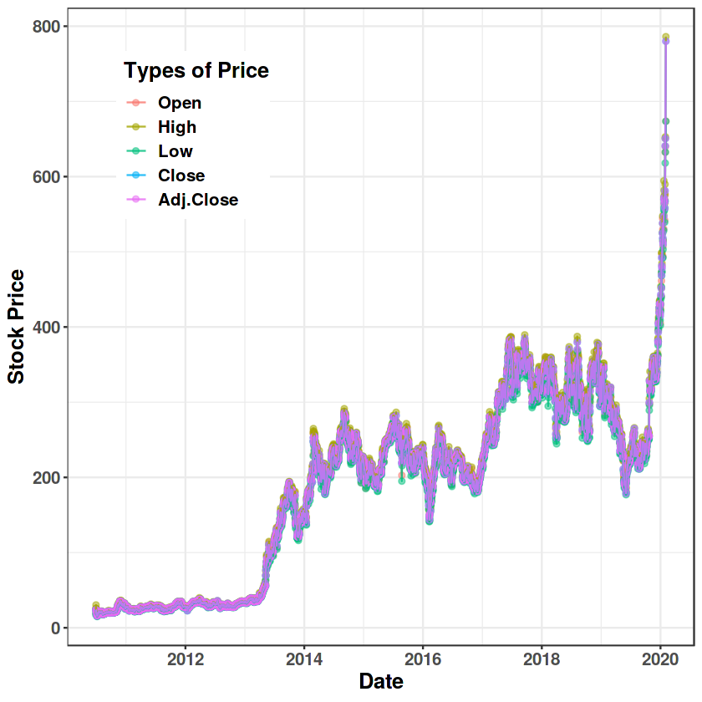
This graph gives a summary of the dataset.

Slide 8
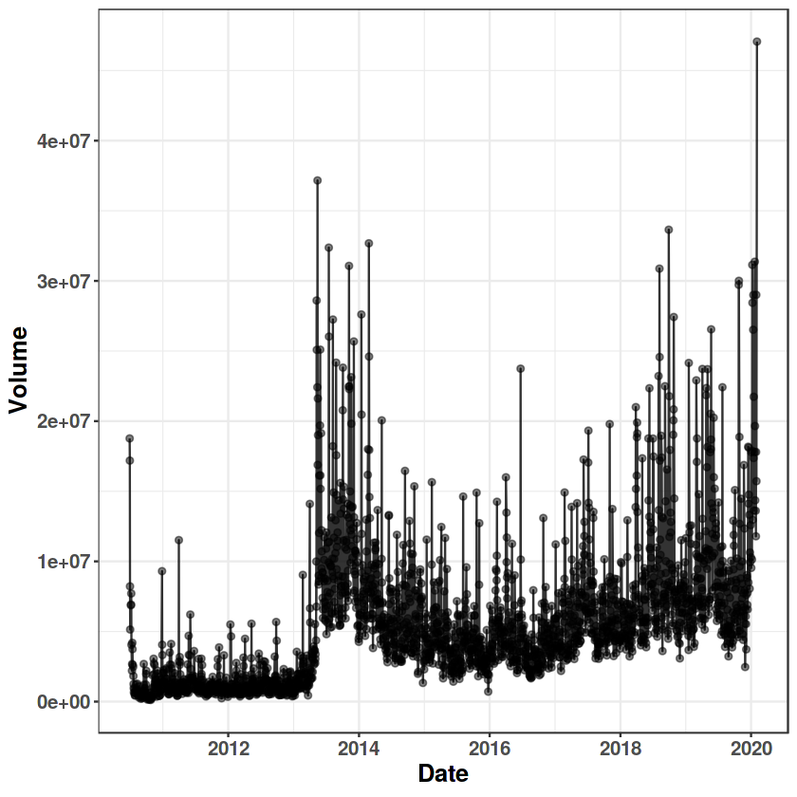
This graph shows the volume of shares throughout the years.

Slide 9
Neural Network Models
Feed Forward Model
Back Propagation Model

Slide 10

Feedforward Model
A feed-forward neural network is a biologically inspired classification algorithm. It consists of a number of simple neuron-like processing units, organized in layers and every unit in a layer is connected with all the units in the previous layer.

Slide 11
Back Propagation Model
Backpropagation is the essence of neural network training. It is the method of fine-tuning the weights of a neural network based on the error rate obtained in the previous iteration. Proper tuning of the weights allows you to reduce error rates and make the model reliable by increasing its generalization. This method helps calculate the gradient of a loss function with respect to all the weights in the network.

Slide 12
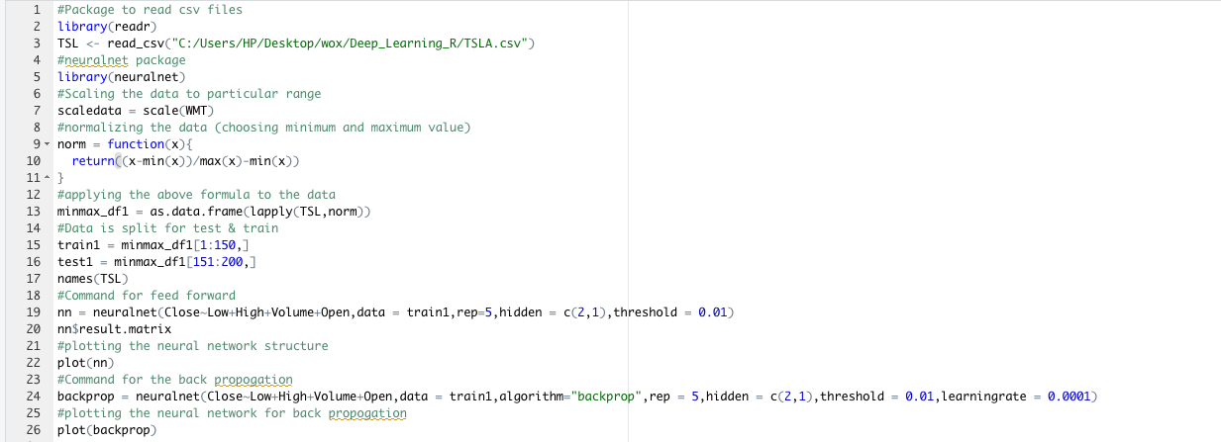
Code for Neural Network Models:

Slide 13
Neural Network Structure
The code was ran in R-Studio with Rep count of 5 and the respective output is as follows.

Slide 14
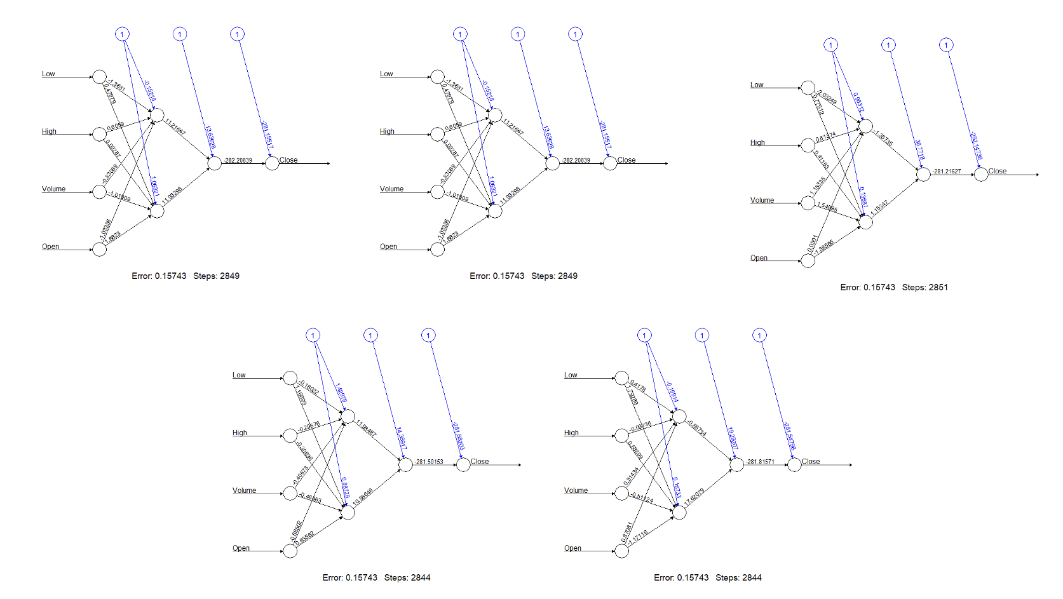
Output for feedforward model:

Slide 15
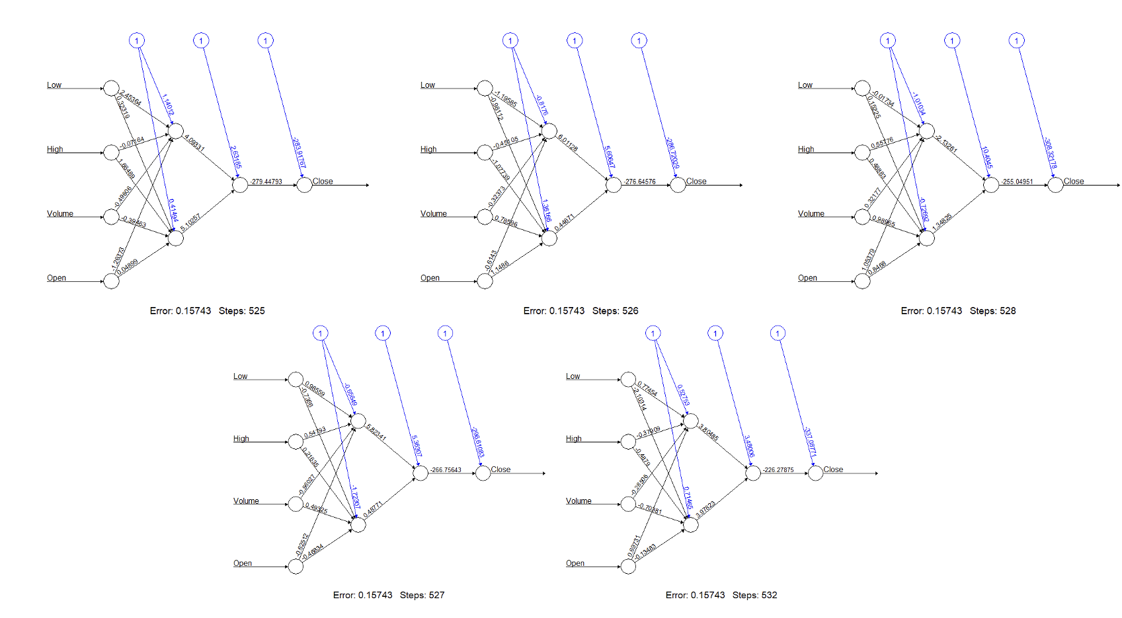
Output for back propagation model:

Slide 16
Observations:
Running through the outputs of both Feed Forward & Back Propagation there is no big difference identified.
Steps has been reduced in Back Propagation but the error rate seems to be almost the same.
Back Propagation is one of the most common techniques used in forecasting of financial time series data.

Slide 17
THANK YOU
Submitted To:
Dr Rajesh Kumar KV

